Slide 1

SEND Information Report
(2025-26)
A parent guide to SEND at Hawkesley

Slide 2

Inclusion at Hawkesley Church Primary Academy
At Hawkesley Primary Academy, we aim to raise the aspirations of and expectations for all pupils, including those with special educational needs, or disabilities (SEND). We endeavor to achieve maximum inclusion of all children, whilst meeting their individual needs.
We make every effort to narrow the gap in attainment between vulnerable groups of learners compared to others, focusing on individual progress as the main indicator of success. We strive to make a clear distinction between a child who is classed to be underachieving, compared to a child with a SEND.

Slide 3

Built upon the foundations of Christian Faith

Slide 4

Hawkesley’s – Lighthouse Keepers’ Approach
Our approach to special educational needs, or disabilities (SEND) is centered around True Inclusion. As a Church school, our school ethos, visions and values are at the heart of the service and support that we provide to our children and their families. True Inclusion is a holistic approach to meeting pastoral and educational needs.
When supporting learners with SEND, we follow Hawkesley’s ‘Lighthouse Keepers’ Approach’ – to light the best route through stormy seas, enabling them to ‘Let their Light Shine’ (Matthew, 5:16) and to ‘Live Life in its Fullness for All’ (John, 10:1-10).
We recognise that all learners have the same end points, but their journey in reaching that point may look different, as we look to provide them with the support and tools they need to achieve their greatest aspirations – ‘Therefore welcome one another as Christ has welcomed you, for the glory of God’. (Romans, 15:7).
‘Shining in the darkness, guiding you through the storm’

Slide 5
Who can I ask for help if I have a concern about my child?
Attendance & Learning Mentor
(Mrs Grainger)
Class Teachers
Teaching Assistants
Family Support Worker
(Mrs Preston-Hunt)
Who you can talk to…
Office Staff
(Mrs Pigott & Mrs Smith)
Inclusion Leader & SENDCO
(Mr Sale)
Senior Leadership Team (SLT)

Slide 6

Who is the SENDCO?
Our Inclusion Leader and SENDCO is Mr Adam Sale.
Mr Sale has been at Hawkesley Church Primary Academy since 2018 and has been the designated SENDCO since September 2022. He completed his National SENDCO Award with the University of Birmingham in July 2023.
The SENDCO’s role is to oversee and manage the provision and support for children with SEND throughout the school.
We have an open-door policy, please do not hesitate to get in touch if you have a query about SEND provision and support.
If you need to contact Mr Sale, please contact the school on 0121 459 6467 or email: enquiry@hawkesley.bham.sch.uk. With the subject add ‘FAO Mr Sale SENDCO’
Alternatively, you can approach me in person when you see me outside during drop-off or pick-up times.

Slide 7

What is a Special Educational Need or Disability (SEND)?
“Children have special educational needs if they have a learning difficulty which calls for special educational provision to be made for them.” - Code of Practice, 2014
What kind of SEND of do we provide provision for?
Cognition and Learning. This area of need refers to those children who learn at a slower pace than their peers, even with appropriate differentiation is put into place. It also can include dyslexia, dyscalculia and dyspraxia.
Communication and Interaction Needs. This includes needs associated with: Autistic Spectrum Conditions, Speech & Language delay and other communication difficulties.
Social, Emotional, Mental Health (SEMH) Needs. This includes additional needs around behaviour, social support groups, emotional well-being and difficulties with mental health.
Sensory and Physical Needs. These are needs such as hearing impairment, physical needs, medical issues or wider sensory needs.

Slide 8


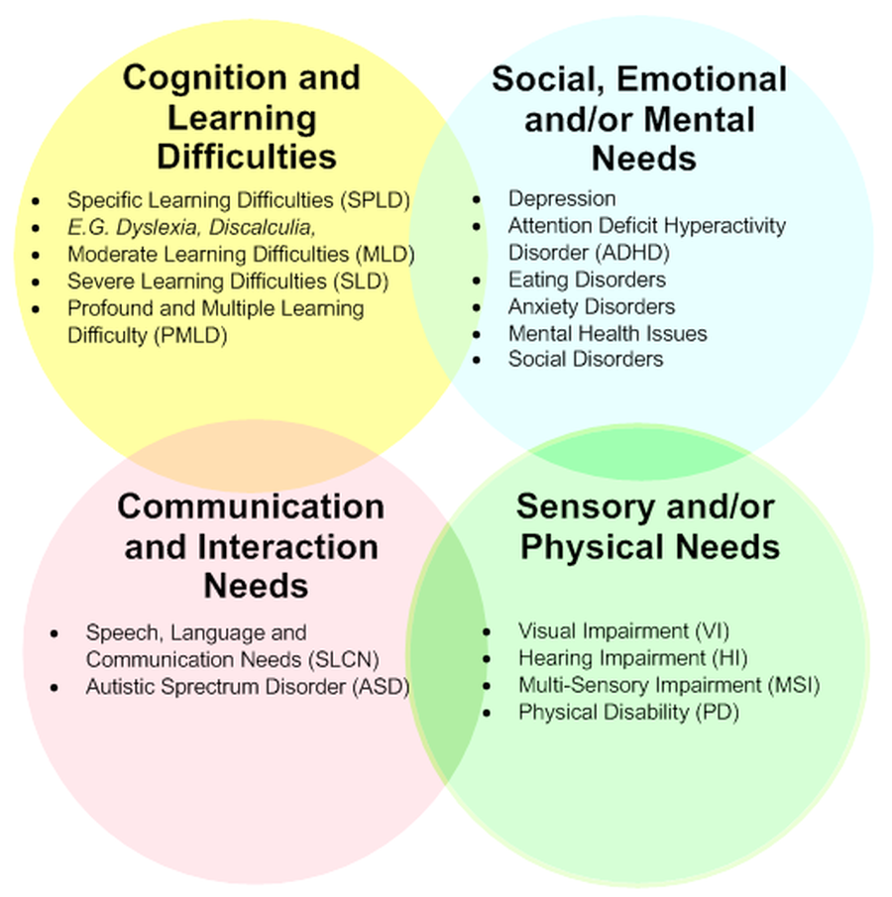


Areas of Special Educational Needs at Hawkesley
There are currently 54 children (25% of the school) recognised as having SEND*
21%
26%
49%
8%
*(%’s based on SEND Register as of Sept 2025)

Slide 9
Who else do we work with to support those with SEND?
Learning, Language and School Support
Educational Psychologist
Beacon SEMH Support
Pre/post-tutoring
Mental Health Support Team
Specific Interventions: phonics, spelling, maths etc…
Forward Thinking Birmingham
Play Therapy
Communication & Autism Team
Internal support from our Family Support Worker
Speech & Language Therapy
Vision & Hearing Specialists
Occupational Therapy
School Nurse Service
Physiotherapy
1:1 Mentoring

Slide 10
How do we identify and assess for SEND?
Baseline assessment indicating poor early learning skills at the start of Early Years Foundation Stage
Ongoing teacher and TA observation and assessment within the classroom, and/or attainment in annual standardised tests
If the child is working below the age-related expectation for that Year group
The attainment gap between the child and their peers is getting wider
If a previous rate of progress is not being maintained
If little progress is being made even when teaching approaches and resources have targeted a child’s identified area of weakness
The class teacher’s termly assessments are showing underachievement in one or more curriculum areas
Emotional or behavioural difficulties persisting despite the use of the school’s behaviour management programmes
Self-help skills, social and personal skills inappropriate to the child’s chronological age
Diagnosis of a previously unidentified medical condition, communication problem or sensory impairment
For a child who is new to the school, records from the previous school indicating that additional intervention has been in place
Parental concerns regarding academic progress, behaviour, social adjustment and/or communication skills

Slide 11

What are the different levels of SEND support available?
Wave 3 - Specialist
Highest-need children with a statutory plan in place, which outlines provision.
They have an SSPP or an EHCP.
Children awaiting Special School Placements.
Wave 2 - Targeted
Children who have support from external specialists, such as: PSS, CAT, EP
Teachers to follow advice made.
Extra interventions may be put into place.
Children may be on ‘continuum work’, which means they are working towards individual targets, to make rapid progress and close the learning gap.
Wave 1 - Universal
Most pupils on the SEND register.
Needs are met by the Class. Teacher through QFT in class.
Needs / Progress reviewed termly.

Slide 12

How do we consult with and involve parents & pupils?
The school will put the pupil and their parents at the heart of all decisions made about special educational provision.
We will formally notify parents if it is decided that a pupil will receive special educational provision.
When we are aiming to identify whether a pupil needs special education provision, we will have an early discussion with the pupil and their parents.
We will keep regular communication with parents, providing them updates as provision develops over time.
You will be invited to attend the SEND parents’ evening, which allows extra teacher/parent discussion to review your child’s SEND pupil profile.

Slide 13

Our SEND pupils’ experience – A snap-shot!
“I do extra phonics and reading interventions to help me catch up!” – Y3 Student
“I have ADHD, so it helps me to have a fiddle-toy. I also get extra time to complete tasks” – Y6 Student
“The teachers help me do my best in my work, I get extra help ” – Y1 Student
“Because of my autism, I can get very anxious. So I have a purple card which allows me to seek space and help, whenever I need it” – Y5 Student
“My teacher finds ways to make work easier for me to understand ” – Y2 Student
“I struggle to see, so I am sat right at the front and have a special board to write on ” – Y5 Student
“Whenever I’m struggling, my teacher comes and sits next to me to help” – Y4 Student

Slide 14

Our SEND pupils’ parents’ experience – A snap-shot!
“Thank you for making the reasonable adjustments for my child with her eye-sight and difficulty writing”
“The staff here are kind and understanding towards my son who has complex needs. Thank you helping him”
“My autistic son has received support from the CAT team to advise the teacher how to work with him”
“I really appreciate the extra support, sometimes 1:1, that my child has received from his teaching staff”
“We much prefer the new SEND pupil profiles and are pleased to have additional time with teachers during SEND parents evening”
“I have been really pleased with the communication between myself and my daughter’s teachers”

Slide 15
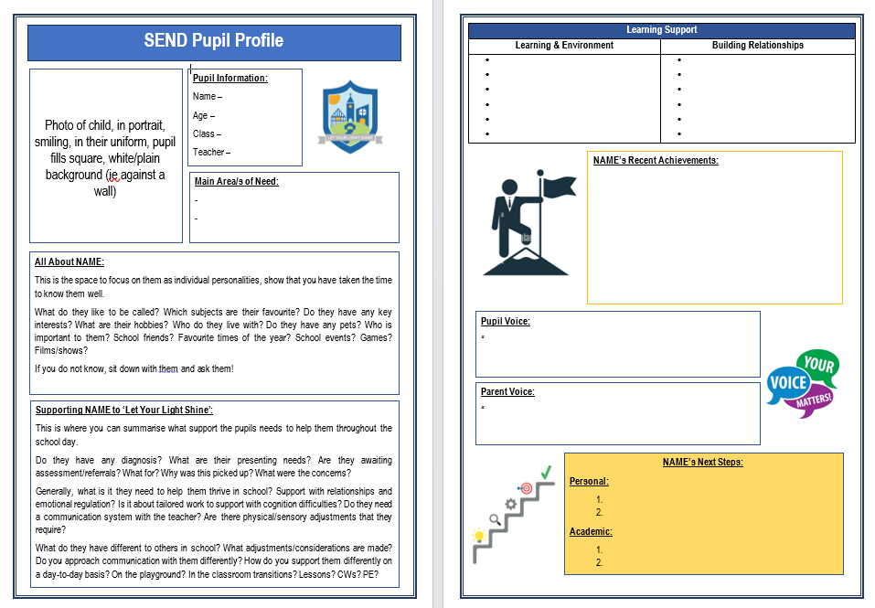
SEND Pupil Profiles
Each pupil on the SEND register will have an individual learning plan, called a SEND Pupil Profile, created for them by their class teacher. It focuses on their personality, characteristics, area of need, adaptations required, support received, recent achievements and offers opportunity for parent/pupil voice.
This is a working-document, updated regularly and shared/reviewed with parents/pupils during a SEND Parents’ Evening (SEND Parents have double the amount of appointment time to non-SEND pupils).
Here is a template:

Slide 16
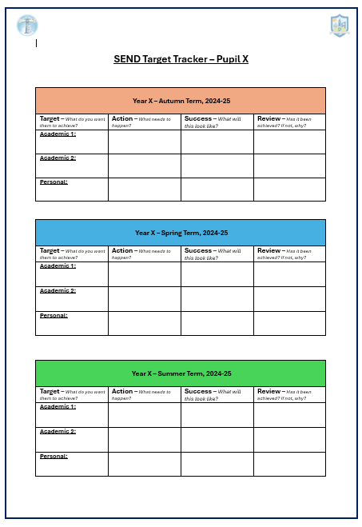
SEND Target Trackers
Each pupil on the SEND register will have an their termly targets from the SEND Pupil Profiles updated on a SEND Target Tracker which evidences their termly targets, what was done and whether they have achieved it or not. It collates a clear record of their journey throughout their time at Hawkesley and is a key document to review for progress tracking and for any transitions to a new school.
This is a working-document, updated regularly and shared/reviewed with parents/pupils during a SEND Parents’ Evening (SEND Parents have double the amount of appointment time to non-SEND pupils).
Here is a template:

Slide 17


How will we help prepare children with SEND for their next transition?
At Hawkesley, we have worked hard to ensure that there is a successful transition programme to support induction at new schools and transition to new classes.
• Year 6 teachers and the SENCo work closely with Secondary feeder schools – meeting with their SEN Team and Year 7 Head of Year as well as accompanying Year 6 pupils with SEND on additional visits/or in-person meetings during the Summer Term, if appropriate.
• The school has a clear approach to transition which makes the necessary adjustments for all children with SEND, which includes:
1. Transition sessions are organised between all Key Stages for children, these sessions also account for parents building a relationship with their child’s new teacher.
2. There is a clear transfer of data and relevant information between all staff. These are communicated both verbally and saved onto our secure system.
3. SEND Pupil Profiles are reviewed and shared with their new teachers.
4. During the Summer term, teachers have allocated time to discuss their new children for the following academic year.
5. There is a parents evening where you are encouraged to drop-in to meet your child’s new teacher and raise any initial queries or concerns.

Slide 18
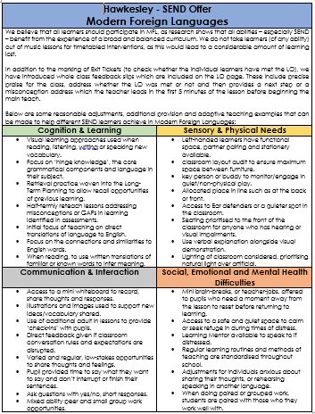
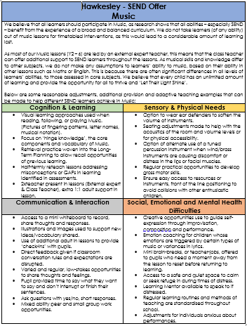
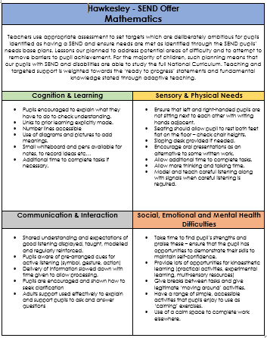
How are SEND Pupils supported throughout the curriculum?
On our website, you can find the SEND offer for every subject, which outlines reasonable adjustments, provision and additional support that can be provided to learners within each of the main areas of SEND need.
Here are some examples – Maths, Music and MFL.

Slide 19
How do we evaluate the effectiveness of SEN provision?
Tracking pupils’ progress, using regular assessment, analysing the results within Toolkit Tracker to track progress over time
Carrying out the review stage of the graduated approach in every cycle of SEN support
Using pupil voice at the center of our approach
Monitoring by School Leaders through regular learning walks, book looks and pupil voice
Class Teachers receive tailored, weekly instructional coaching to support the development of their practice
Holding annual reviews for pupils with EHC plans
Getting feedback from the pupil and their parents, during termly SEND meetings where the provision is agreed

Slide 20

How are parents/carers involved with their child’s journey?
Regular informal communication with teachers (in person or via dojo messenger)
SEND Parents’ Evenings and Celebration Events
Annual reviews of SSPPs and EHCPs
Through SEND focused coffee mornings and/or parent workshops
Through informal discussions with class teachers, TAs, our SENCo or SLT.
Open Door Policy: Parents are regularly invited to meet with teachers, the SENCo, and external professionals to discuss needs

Slide 21

How do we involve the children in their journey?
Whenever possible, the views of the children are listened to and acted upon. This is true in all areas of school but especially for those with Special Educational Needs.
We work hard to tailor support that children themselves are comfortable and happy with. Children are invited to take part in termly reviews and when appropriate, are invited to SSPP and EHCP reviews.
Within SEND Parents’ Evenings, teachers share/review the child’s SEND pupil profile which provides characteristic description, additional needs, provision required, recent achievement and provides opportunity to gather parent and pupil voice. These meetings occur termly.

Slide 22

What training do teaching staff receive to support children with SEND?
Staff receive regular training from Senior leaders, as well as the SENDCO, in the delivery of quality first teaching in the classroom.
Those who have children with a diagnosis or specific concerns, may receive training from one of our external agencies including the Learning, Language and School Support (LLaSS) teacher, the Communication and Autism (CAT) team, our speech and language therapist, our Educational Psychologist or disability support team
Staff also receive personalised behaviour support training from Beacon SEMH support if a child’s needs has an effect of their behaviour. All staff receive annual training on Asthma and Allergy management.
SEND will always remain a priority when planning training for staff.

Slide 23

How accessible our school environment?
Residentials/day trips have detailed risk assessments completed and we ensure all needs are catered for.
Our school is wheelchair accessible and we have disabled toilets. The school is all on the ground floor.
Reasonable adjustments are made for any learners who require additional support around school.
Risk assessments are made and shared with staff/parents for those with physical disabilities or an injury.
Working environments are adapted as much as possible for children who require low sensory, quiet/calming areas with minimal opportunity for distraction.

Slide 24


What is Birmingham’s Local Offer for SEND and where can I find it?
Birmingham’s Local Offer identifies what is available for those children in Birmingham with a Special Educational Need.
The link for this can be found here - Local Offer Birmingham | SEND Advice, support and Information
Contact details for Birmingham’s SEND support service:
Birmingham SENDIASS Tel. 0121 303 5004, Email: sendiass@birmingham.gov.uk

Slide 25

If I am unhappy, who shall I speak to first?
How do I make a complaint?
In the event of any complaint being made, the SENCo should be contacted in the first instance; should the matter remain unresolved:
The case will be passed to the Head teacher for further investigation and reported to the SEND Governor, Larry Wright.
These are the recommended stages of complaint:
Class Teacher
SENDCO
Head Teacher
Lead Governor for SEND, Rev. Larry Wright

Slide 26

Useful Links to SEND Services
BCBC Speech & Language Therapy - Birmingham Speech and Language Therapy Service : Birmingham Community Healthcare (bhamcommunity.nhs.uk)
SENAR - Contact - Local Offer Birmingham
SCHOOL WEBSITE - Hawkesley Church Primary Academy - Home
Forward Thinking Birmingham - Home | Forward Thinking Birmingham
Central Autism Team - Communication & Autism Team – Access to Education (birmingham.gov.uk)
Educational Psychology Service – Birmingham Educational Psychology Service | Birmingham Education Support Services
Pupil & School Support - Pupil & School Support – Access to Education (birmingham.gov.uk)

Slide 27

Glossary of SEND Terms and Acronyms
SEND – Special Educational Needs and Disabilities
SENDCO – Special Educational Needs and Disabilities Co-ordinator
EHCP – Educational Health Care Plan
SSPP – Special Support Provision Plan
LLaSS – Language, Learning and School Support
CAT – Central Autism Team
EP – Educational Psychologist
SALT – Speech & Language Therapist
OT – Occupational Therapist
EYFS – Early Years Foundation Stage (Nursery & Reception)
KS1 – Key Stage 1 (Years 1-2)
KS2 – Key Stage 2 (Years 3-6)
QFT – Quality First Teaching

